Slide 1
Cardboard Boat
Config 1

Slide 2
Design
Cage and skin structure
Internal cage for longitudinal load distribution
Keeps hull skin from having to carry longitudinal bending moment and out-of-plane shear (boat won’t fold up when wet)
Beams can be isolated from water (wrap in strapping tape)
Modular bay structure carries full load of 1 pax (175 lbs)
Add bays to add pax
Single piece skin folded to correct shape and strapped around cage (strapping tape)
No hull penetrations, slow to take on water
Skin still provides reasonable torsional rigidity when wet
Config 1 (full scale)
Kayak-like configuration
Seat depth of 1 in below WL, height of 4 in. above floor
Four beams, 2 in. square, glued cardboard lamina, strapping tape
55 deg. sidewall, 35 deg. bow angle, 4 ft. x 33 in. bays

Slide 3
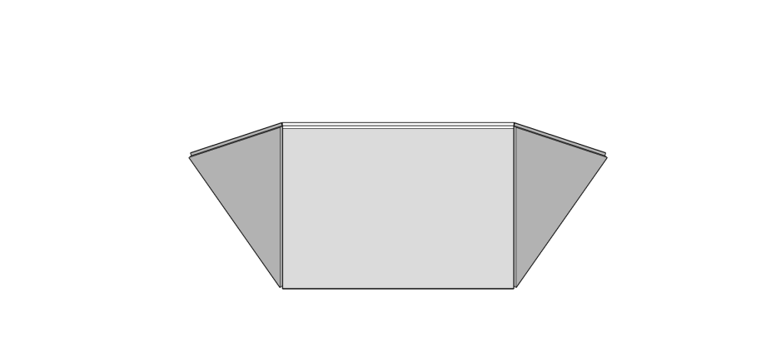
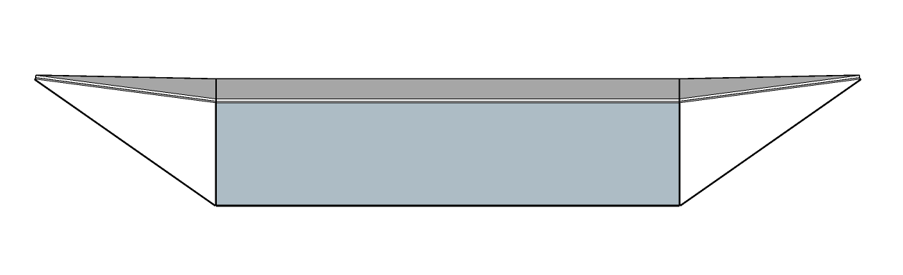
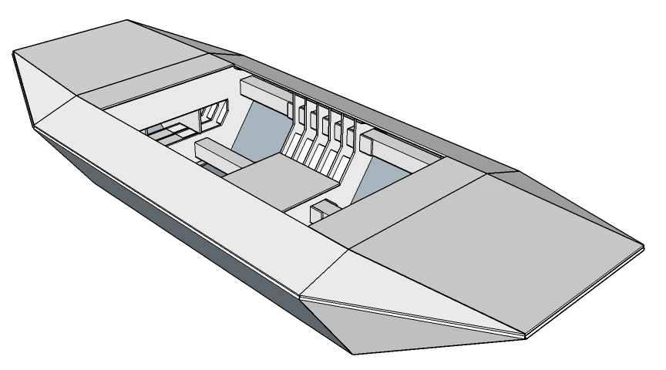
Subscale Test Article
46% scale, single bay model
Single piece hull skin fits on extra large moving box
Design load of 18 lbs (buoyant force scales as L^3)
Structural stress (for a given load) scales as 1/L^2
Structural margin @ design load doubles for a half scale model
“Seat” bulkhead in center for load testing

Slide 4
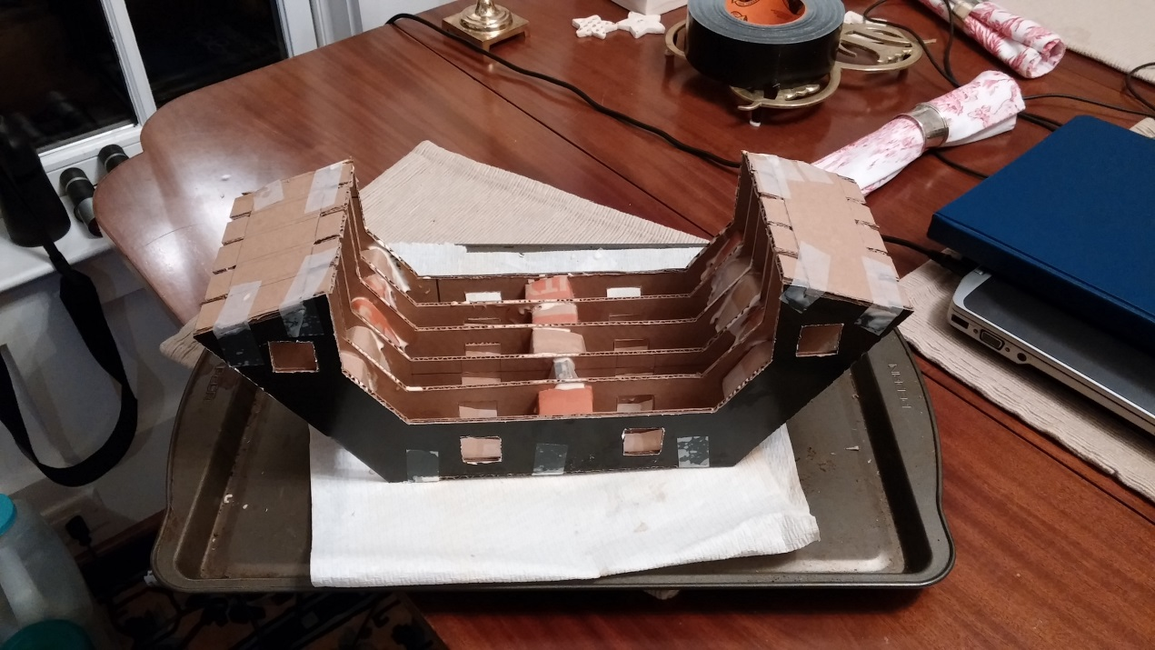
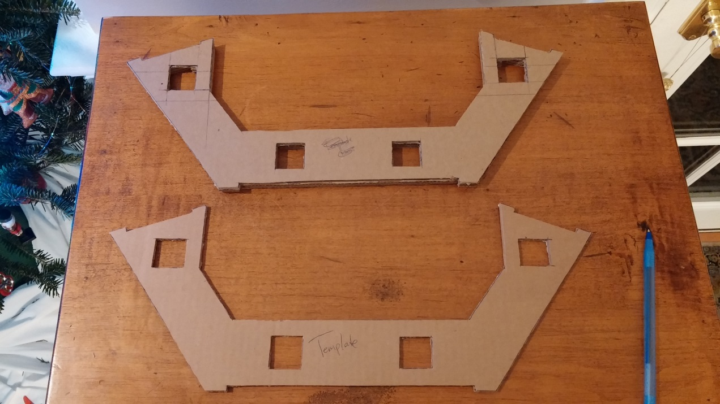
Construction Pics

Slide 5
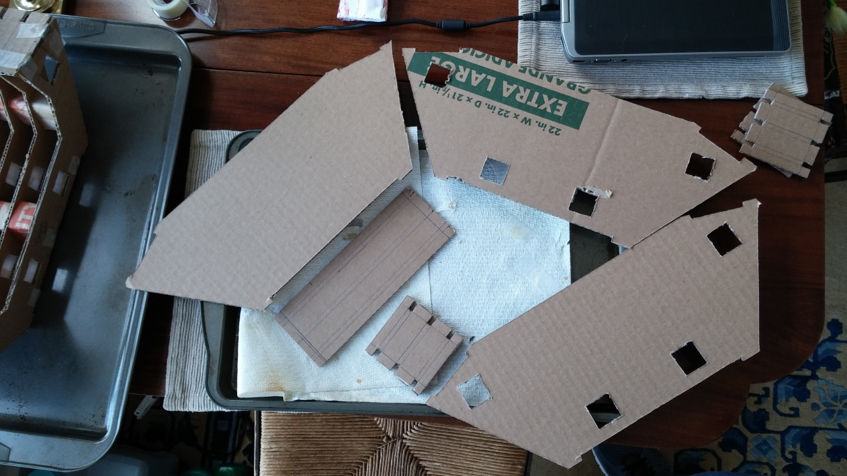
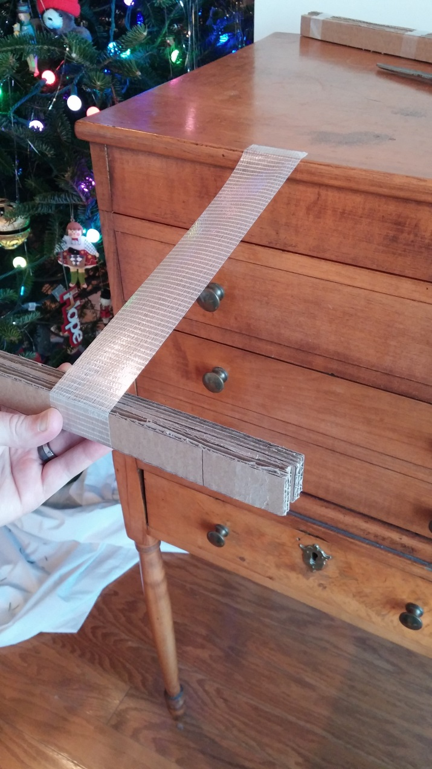
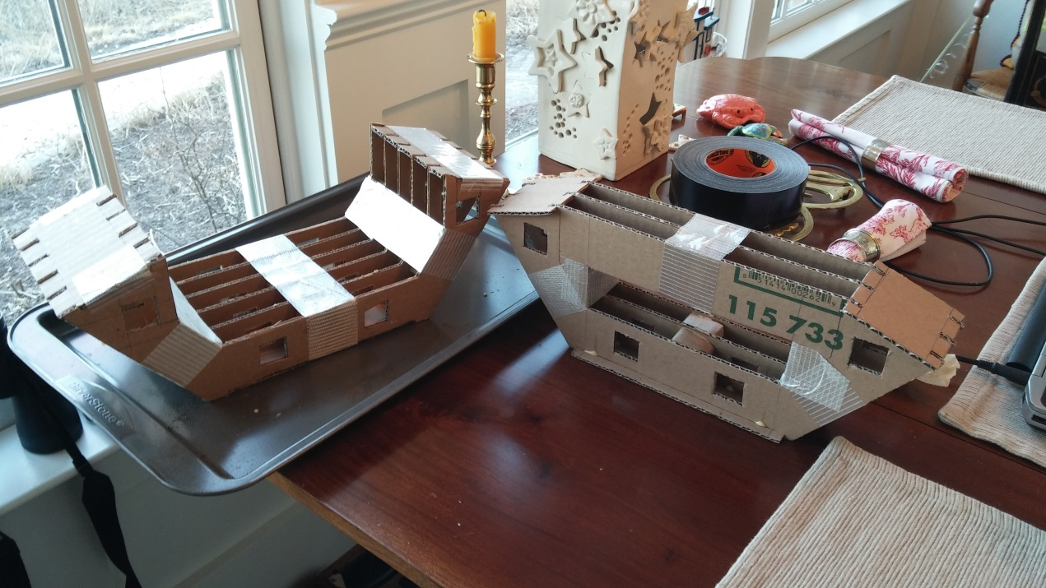
Construction Pics

Slide 6
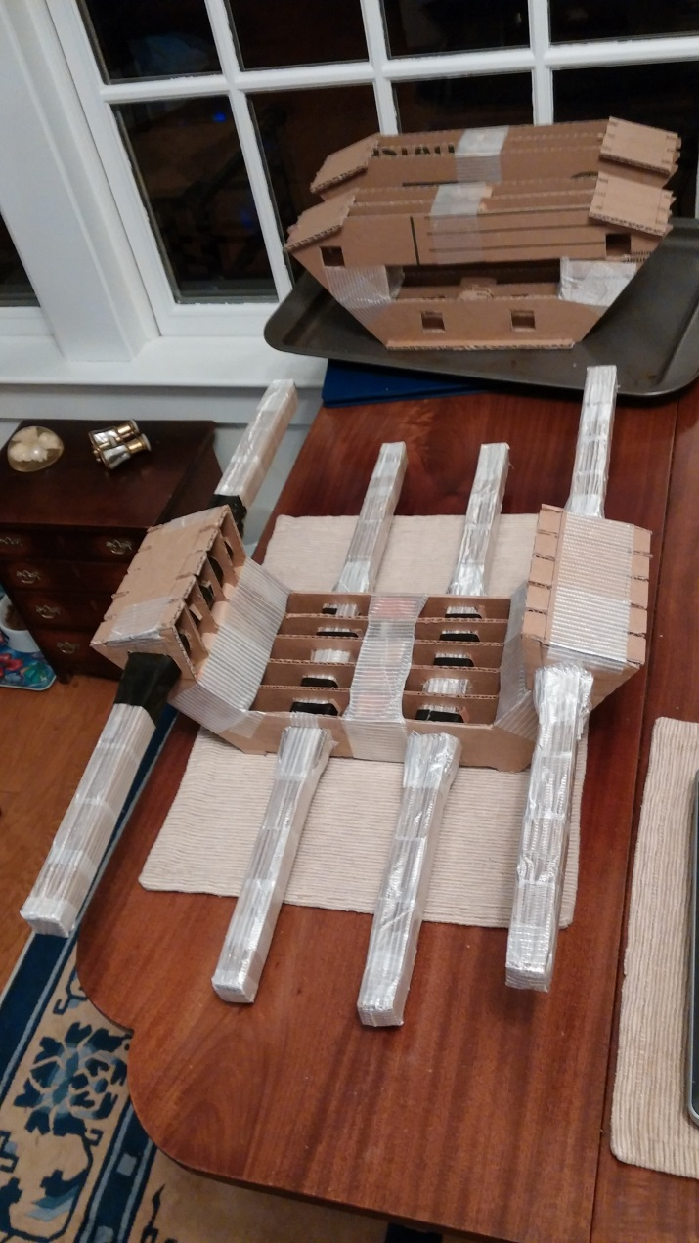
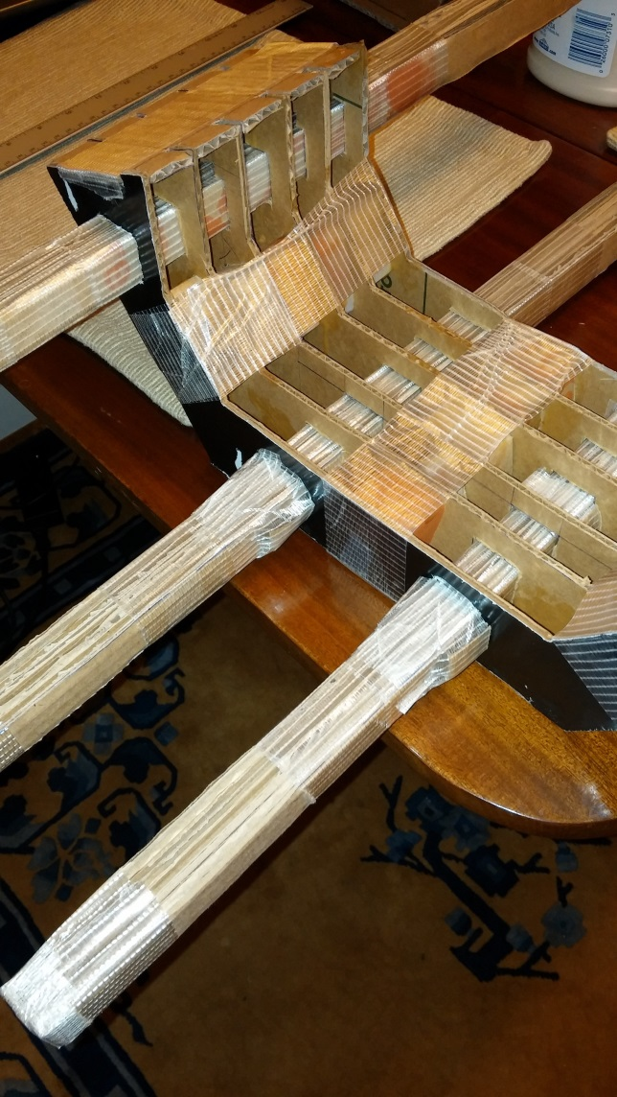
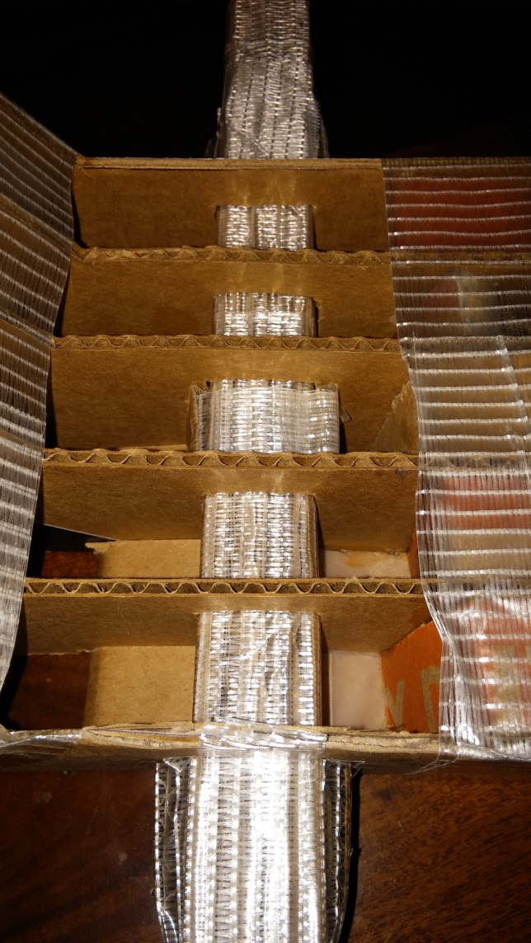
Construction Pics

Slide 7
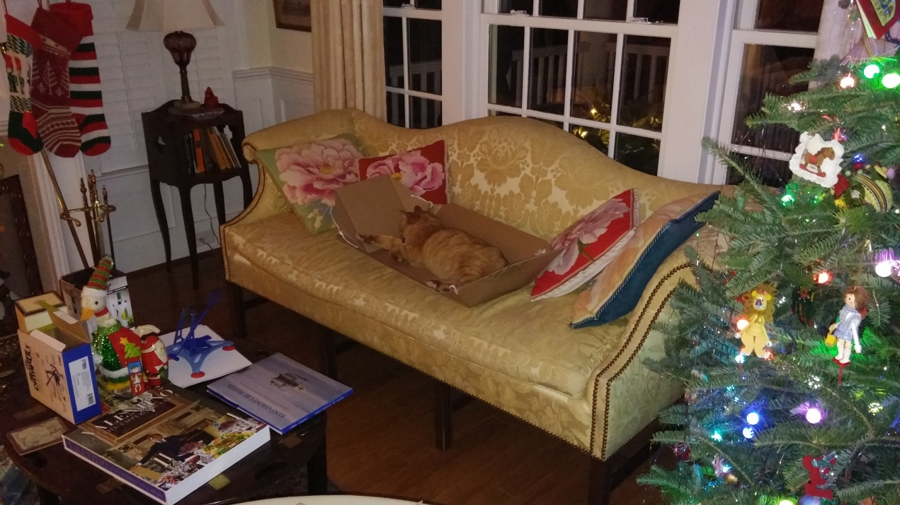
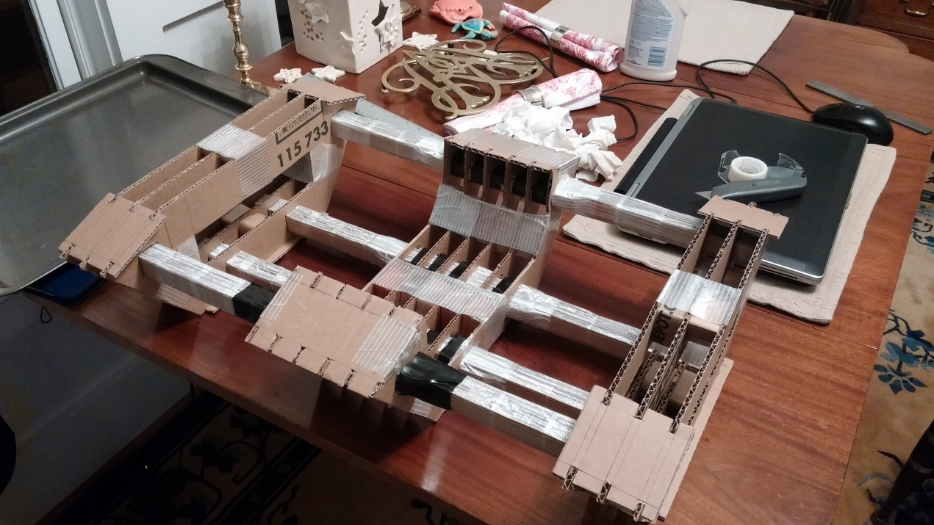
Construction Pics

Slide 8
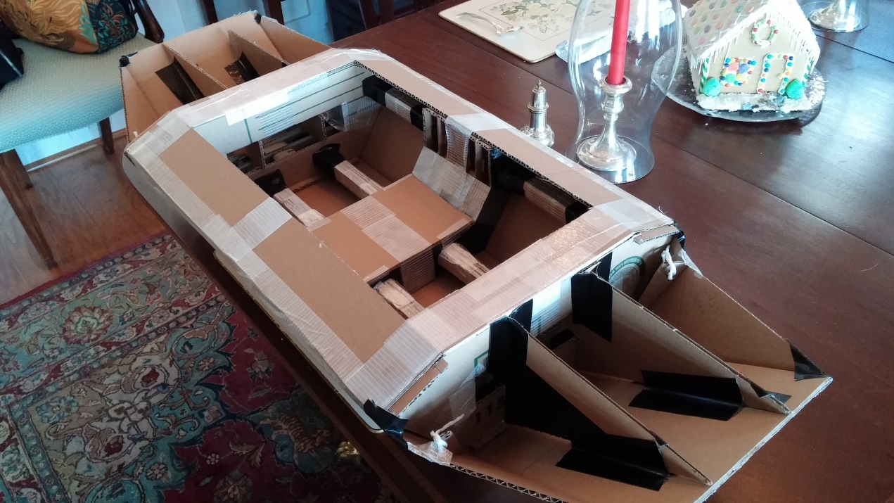
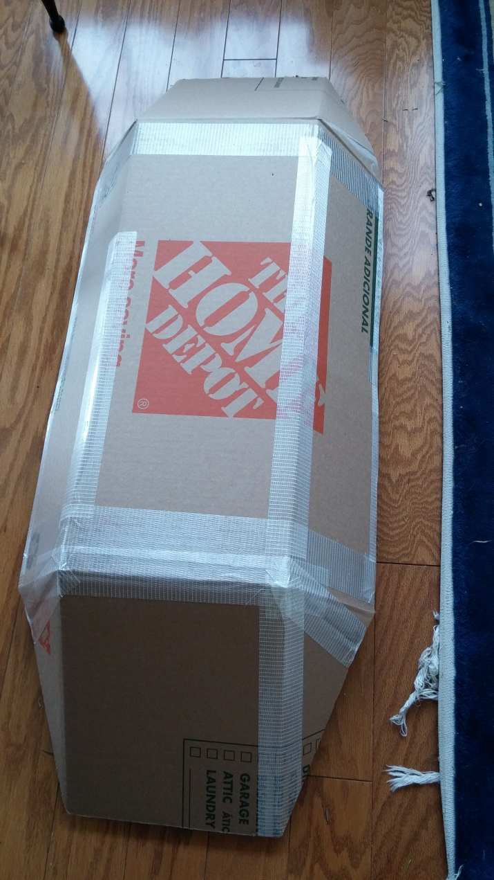
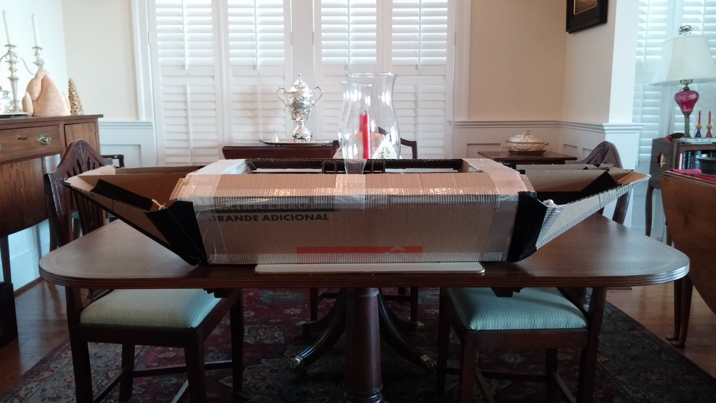
Construction Pics

Slide 9
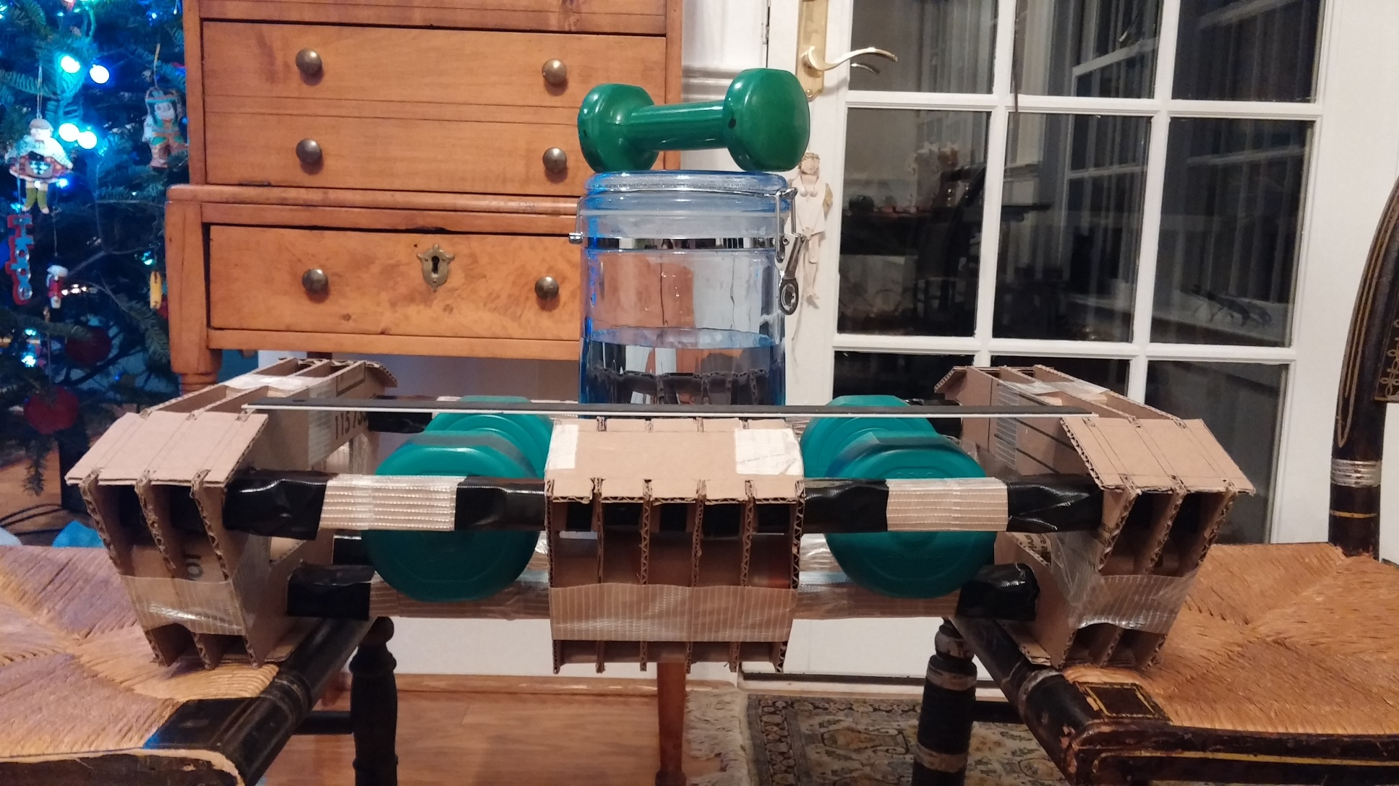
End Supported Load Test
Design Load (18 lbs.)

Slide 10
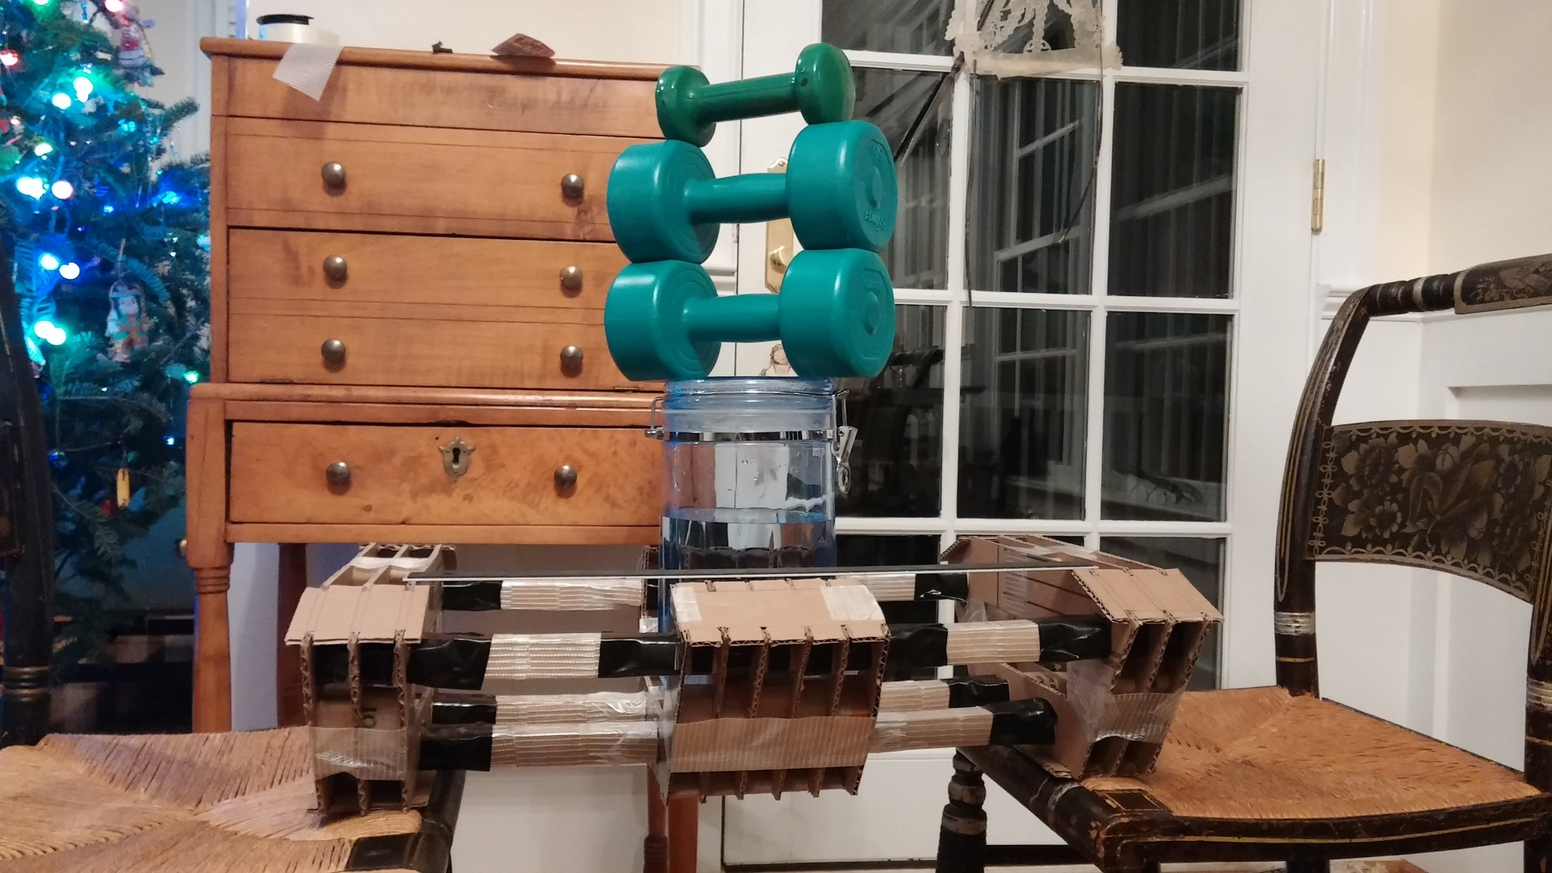
End Supported Load Test
Design Load (18 lbs.), Stacked

Slide 11
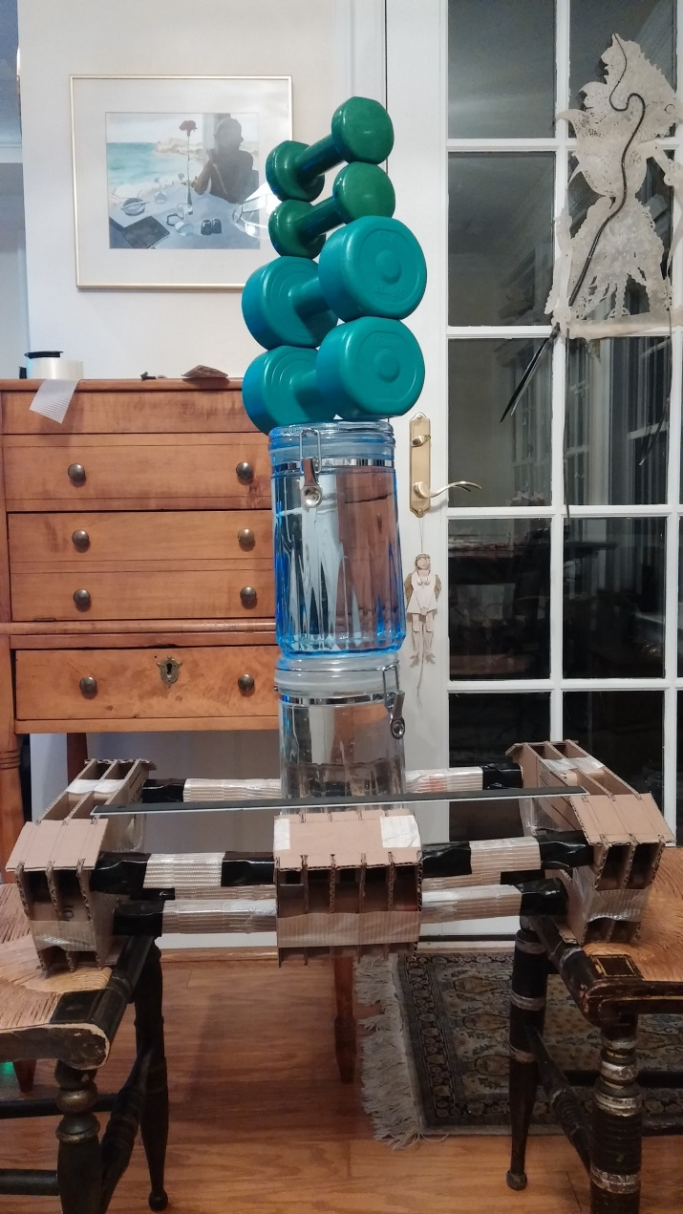
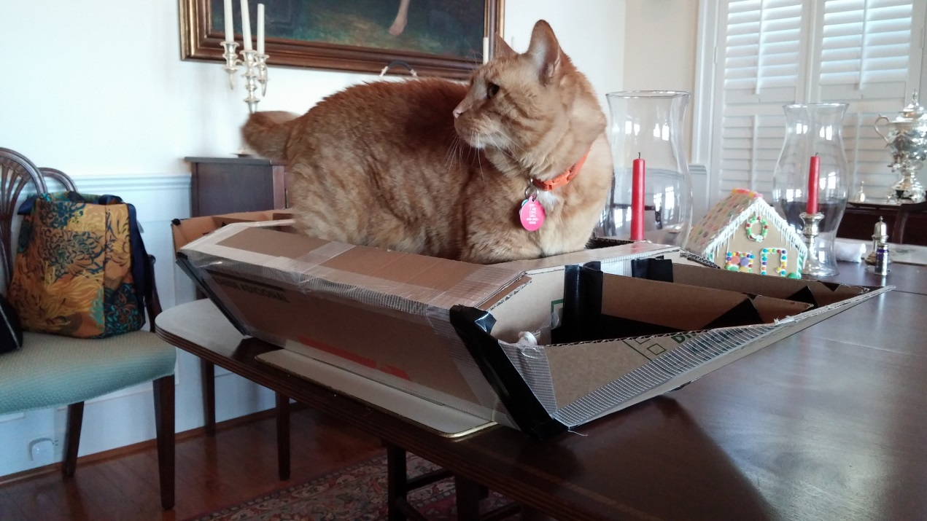
End Supported Load Test
1.66x design Load (30 lbs.), Stacked
Probably could do 3-4x design load without a problem
Translates to 1.5 to 2x at full scale
End supported load test is already conservative w.r.t. loading in water
Gus approves…

Slide 12
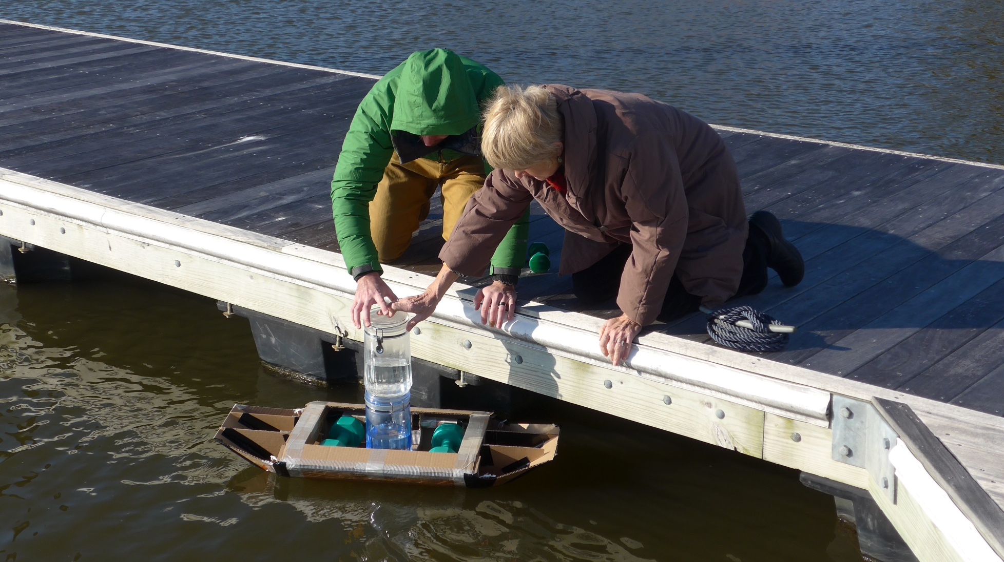
In-Water Test
1x design load (18 lbs)

Slide 13
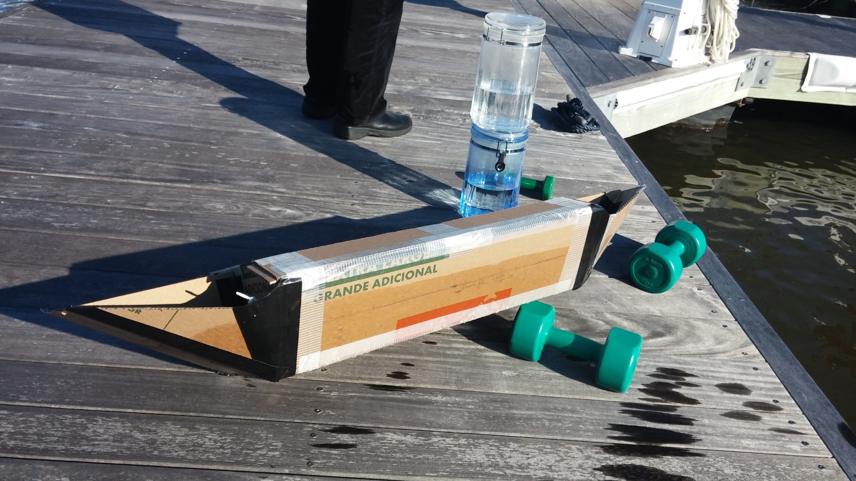
In-Water Test
Design Waterline @ 18 lbs

Slide 14
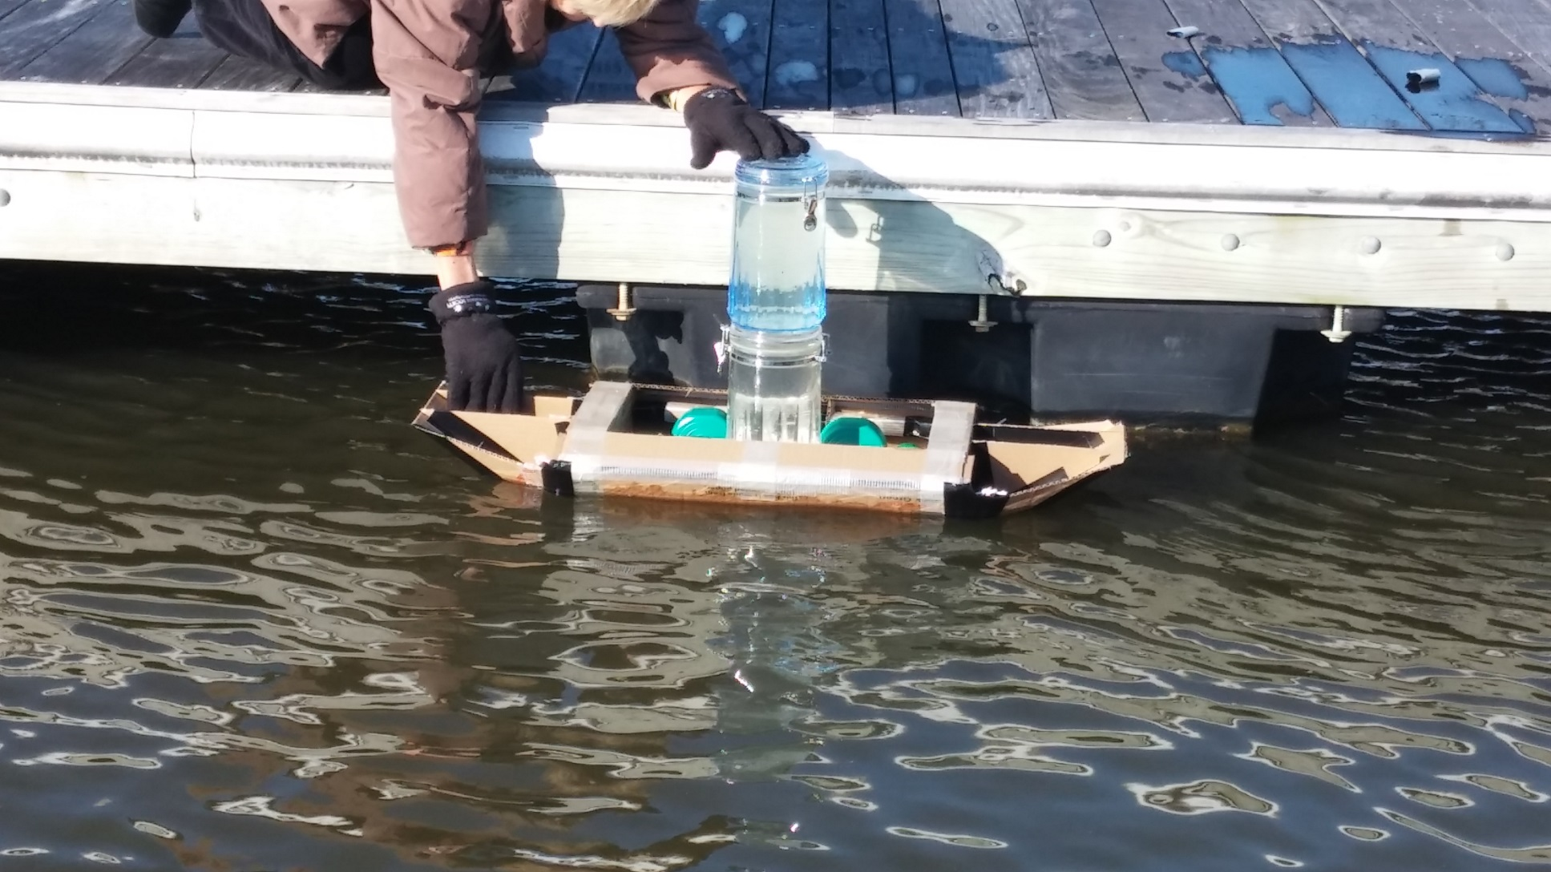
In-Water Test
1.66x design load (30 lbs)

Slide 15
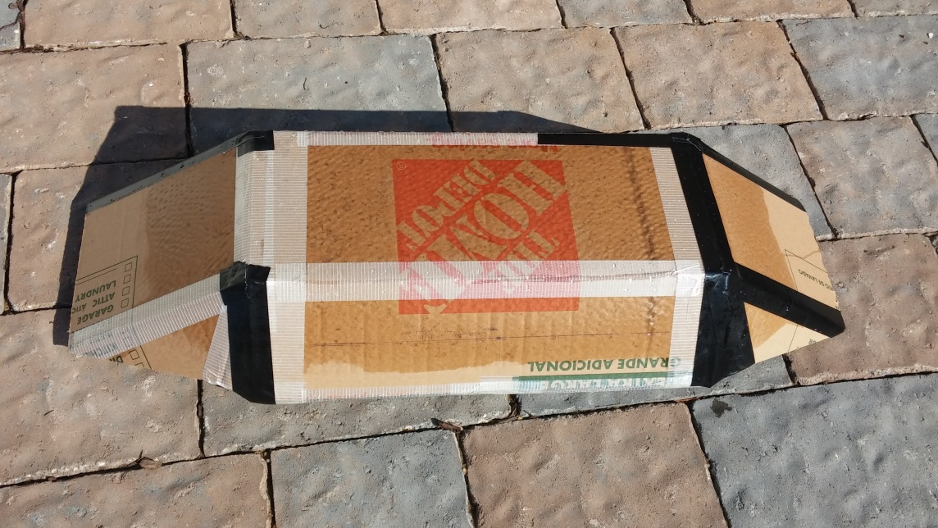
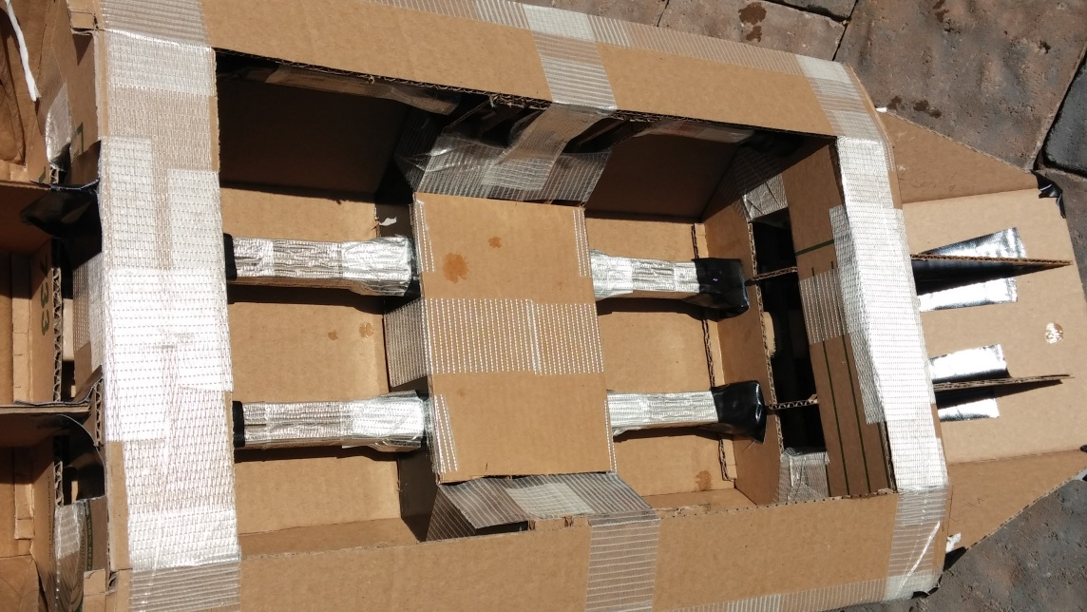
In-Water Test
About 5 minutes in water under load
No noticeable water inside hull
Waterline close to expected location at 1x design load (18 lbs.)
Positive lateral stability, but close to neutral (somewhat tippy)
Tried to get vertical load distribution correct…
Should try to quantify kayak metacenter location and match it…
1.66x design load tested without a problem

